Slide 1
IOT Based child safety gadget for child safety monitoring and notification
Team ID:PNT2022TMID41271
Team Lead: Dharshanraj. V
Team member: Chinnan.S, Keerthiprasath.S ,Koushik.R.P,
Mentor: Dr. DINESH G

Slide 2

Introduction :
Now a days parents are busy with their daily routine they are not able to concentrate on so much attention to their child safety.
In a modern day world we came up with an idea of creating an IOT device to monitor the child location with a geofence.
In this device the parents are able to monitor the child location lively and they know that their child is in the safe zone or not.

Slide 3
Objective of Our project :
Objective of Our Project
Child tracker helps the parents in continuously monitoring the child’s location.
They can simply leave their children in school or parks and create a geofence around a particular location.
By continuously checking the child’s location notifications will be generated if the child crosses the geofence.
Notifications will be send to the sent according to the childs location to their parents and caretakers.

Slide 4
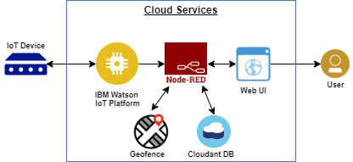
Block Diagram/Flow Diagram

Slide 5

Methodologies :
Python
IBM Watson Cloud
Node-Red
MIT app Inventor
Cloudant db

Slide 6
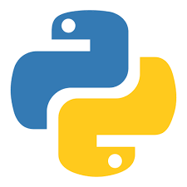
Python :
We have to develop a python script to monitor the child location and then we have to create the geofence.
After creating the geofence we have to develop an alerting notification if the child crosses the geofence and also check the temperature value of the child surroundings.

Slide 7
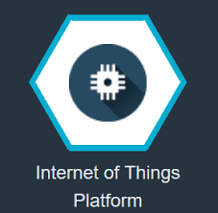
IBM Watson
IBM Watson IoT Platform is a fully managed, cloud-hosted service that makes it simple to derive value from Internet of Things (IoT) devices.
Configure the connection security and create API keys that are used in the Node-Red service for accessing the IBM platform.
Python program is linked to the IBM Watson IOT platform.

Slide 8
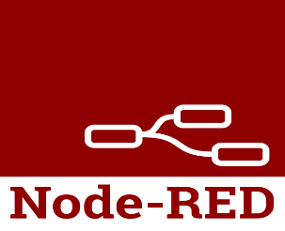
Node-Red
Node-RED is a programming to create functionality by wiring together flows of data between nodes using a browser.
It has gained tremendous popularity in the IoT space, by modeling bits of application functionality between IoT devices like sensors, cameras, and wireless routers.
In our project the nodered is used to connect the app and the IBM Watson.

Slide 9

MIT app Inventor :
MIT App Inventor is a web application integrated development environment originally provided by Google, and now maintained by the Massachusetts Institute of Technology.
We have to develop a app in MIT app inventor.
And then we have to connect the node red and the MIT app inventor.
The MIT app inventor displays the collected information.

Slide 10

Cloudant Database :
Create a Dashboard for storing the child location
It collects all the data obtained from the IBM Watson, Node red and the MIT app inventor and store it.

Slide 11
Demonstration Video
GitHub &Project demo link:
GitHub Link: https://github.com/IBM-EPBL/IBM-Project-35062-1660281178
MIT app apk file link:
https://drive.google.com/file/d/1aH_4e1wuKVZs8d79vqCFjdxVT8m_t4vZ/view?usp=share_link
Project demonstration video link:
https://drive.google.com/drive/folders/13qU3MMWU7uF3dEhzTdTKQ69yW2vIF3c8

Slide 12

Future Scope :
Child’s surrounding can be located with the help of accurate and precise real time location.
Surrounding environment temperature,SOS light along with distress buzzers are provided in this system.
If child crosses the geofence call goes to the registered mobile numbers

Slide 13
Reference :
Proceedings of the Third International Conference on Intelligent Communication Technologies and Virtual Mobile Networks (ICICV 2021).Design of Wearable Device for Child Safety
Proceedings of 3rd international conference on Integrated Intelligent Computing and Communication & Security (ICIIC 2021)IOT based child security monitoring system
2016 Second International Conference on Computational Intelligence & Communication Technology- Child Safety & Tracking Management System.
2020 IEEE 14th International Conference on Semantic Computing (ICSC) -IOT-enabled Smart Child Safety Digital System Architecture

Slide 14
Thank You

